Slide 1
CS30500: Introduction to Software Engineering
Spring 2025
Chapter 3. Agility and Process 1/2
Prof. In-Young Ko
School of Computing

Slide 2
Today’s Plan
Agility
Popular agile methods
Scrum
Extreme Programming (XP)
Kanban

Slide 3



As a Software Engineer…
Your task is to design and develop a smart home system where a butler robot understands the user's needs and seamlessly controls and coordinates home appliances.
What development activities do you plan to carry out?
What would be the most effective development process for this project?
[Generated by ChatGPT 4o]

Slide 4
What would be the most effective development process?
ChatGPT’s Answer:
For a normal development situation (not a fast-track approach), an Agile methodology—specifically Scrum or Kanban—would be the best software process. This ensures continuous iteration, flexibility, and adaptability while developing a complex smart home system like the LG butler robot.

Slide 5
Agility

Slide 6
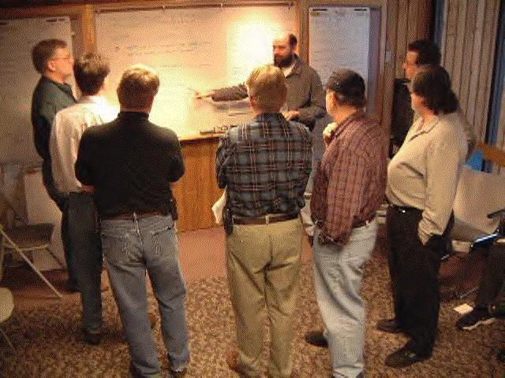
“In February 2001, seventeen software developers met at the Snowbird resort in Utah to discuss lightweight development methods.”
http://agilemanifesto.org/
Notes:
In 2001, seventeen software developers met at a resort in Snowbird, Utah to discuss these lightweight development methods, among others Jeff Sutherland, Ken Schwaber, Jim Highsmith, Alistair Cockburn, and Bob Martin. Together they published the Manifesto for Agile Software Development.

Slide 7
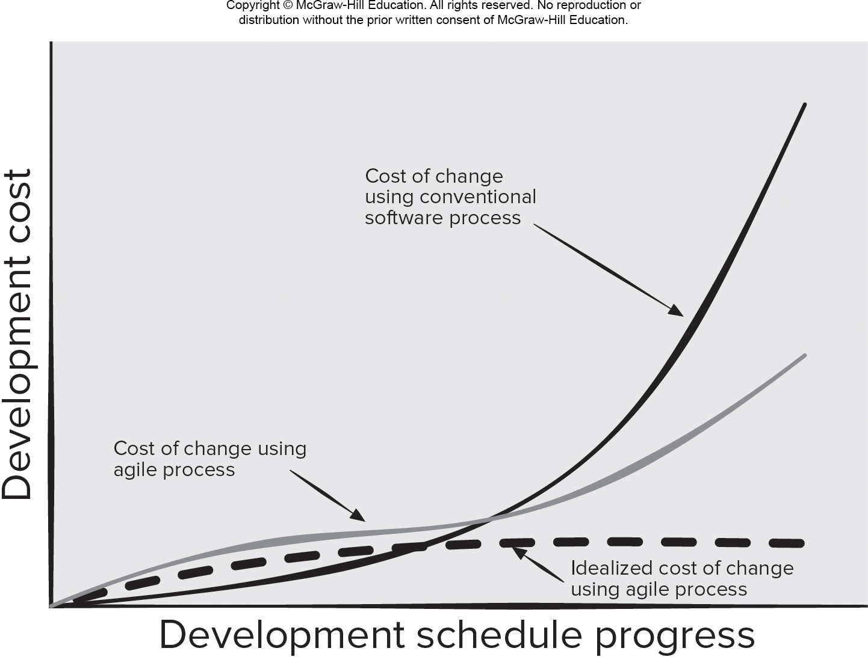
What is Agility?
Effective (rapid and adaptive) response to change
Effective communication among all stakeholders
Drawing the customer onto the team
Organizing a team so that it is in control of the work performed
Rapid, incremental delivery of software
Agility and Cost of Change
[PrMa20 ]

Slide 8
Principles Behind the Agile Manifesto
Early and continuous delivery of valuable software
Welcome changing requirements (even late in development)
Deliver working software frequently (from two weeks to two months)
Business people and developers must work together daily
Build projects around motivated individuals
Face-to-face conversation (within a team)
Working software is the primary measure of progress
Sustainable development (maintain a constant pace indefinitely)
Continuous attention to technical excellence and good design
Simplicity
Self-organizing teams
The team reflects on how to become more effective, then tunes and adjusts its behavior accordingly
Notes:
At the simplest level, a self-organizing team is one that does not depend on or wait for a manager to assign work. Instead, these teams find their own work and manage the associated responsibilities and timelines.
Of course, there’s more to self-organizing teams than simply finding and completing work. Self-organizing teams also take on the responsibility of choosing the most effective and efficient way to complete their work and regularly look for ways to improve through experimentation.
For this structure to work, self-organizing teams must have a high sense of ownership and responsibility. Equally as important, they need to communicate often and trust in the capabilities of everyone on the team.
https://www.planview.com/resources/articles/what-is-self-organizing-team/

Slide 9
Agile Practices
More than 70% of organizations employ agile approaches
Core concept:
Iterative, intensive communication, early customer feedback
Several weeks per iteration
Each iteration delivers a complete working software
Pay less attention to detailed documentations
Close collaboration across the team and with customers
Frequent releases allow continuous improvement
Cons of Agile Methods
Make the maintenance more complicated
Difficult to accurately estimate budget, time and people required for the project
Adopted from Prof. Doo-Hwan Bae’s CS350 lecture material

Slide 10
Self-organizing Team
Does not depend on or wait for a manager to assign work
Finds their own work and manage the associated responsibilities and timelines
Takes on the responsibility of choosing the most effective and efficient way to complete their work
Regularly looks for ways to improve through experimentation
Must have a high sense of ownership and responsibility
Needs to communicate often and trust in the capabilities of everyone on the team
https://www.planview.com/resources/articles/what-is-self-organizing-team/

Slide 11
When is Agile Recommended?
Boehm and Richard Turner. 2003. Balancing Agility and Discipline: A Guide for the Perplexed. Addison-Wesley Longman Publishing Co., Inc., Boston, MA, USA.

Slide 12
Use Cases of Agile Processes
Startup initiatives, when end users’ early feedback is required
Most of mid-sized projects where business requirements cannot be confidently translated to detailed software requirements
Large projects that are easy to divide into small functional parts and can be developed incrementally over each iteration
[Shi19]
Adopted from Prof. Doo-Hwan Bae’s CS350 lecture material

Slide 13
Popular Agile Methods

Slide 14
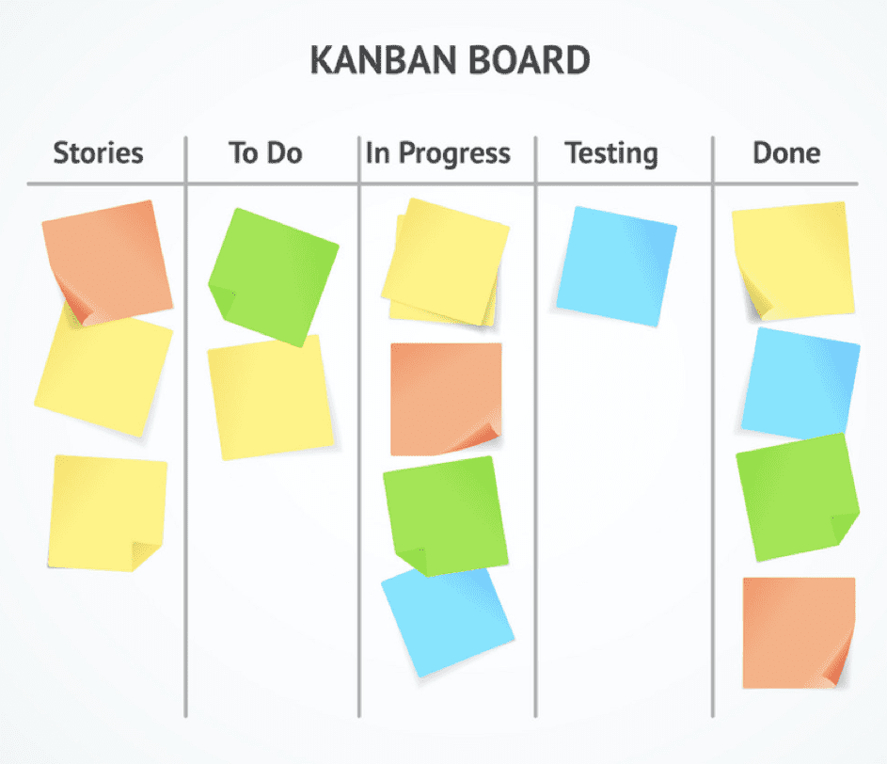
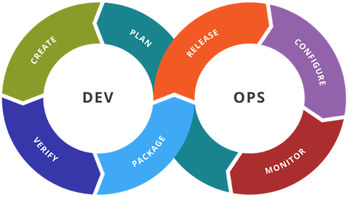
Popular Agile Methods
Scrum
Extreme Programming (XP)
Kanban
DevOps
….
https://www.c-sharpcorner.com/UploadFile/d9c992/the-agile-scrum-framework/
https://www.youtube.com/watch?v=FufRFdFFu4k
https://www.bocasay.com/kanban-method-it-development-projects/
https://ko.m.wikipedia.org/wiki/%ED%8C%8C%EC%9D%BC:Devops-toolchain.svg

Slide 15
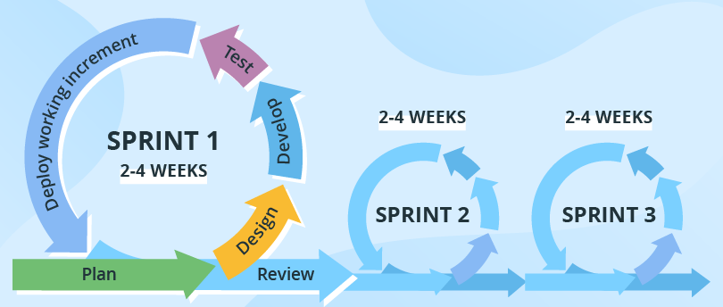
What is Scrum?
The name is derived from a rugby activity (working together with the teammates)
Developed by Jeff Sutherland and his team in the early 1990s
Sprint
An iteration of a framework activity (requirements, analysis, design, …)
2-4 weeks long
Preceded with thorough planning and previous sprint assessment
No changes are allowed after the sprint activities have been defined
[Shi19]
The work tasks to be done within a sprint are defined by the Scrum team
Adapted to the problem to solve
Defined and modified in real time
Number of sprints needs to be decided based on product complexity and size
[PrMa20 ]

Slide 16
Scrum Teams and Artifacts
[PrMa20 ]
Scrum team: A self-organizing interdisciplinary team consisting of a
Product owner: the person who orders the product features and decides whether to end a sprint
Scrum master: a facilitator who runs the daily Scrum meeting, coaches the team members, and helps the product owner to manage the product backlog
Development team: a small (3-6 people)
Scrum artifacts:
Product backlog: a prioritized list of product requirements (a requirement can be added at any time)
Sprint backlog: the subset of product backlog items selected by the team to be completed during the current active sprint (cannot be changed during a sprint)
Code increment: all backlog items completed in previous sprints + sprint backlog items
Development proceeds by breaking the project into a series of incremental prototype development (sprints, 2-4 weeks each)

Slide 17
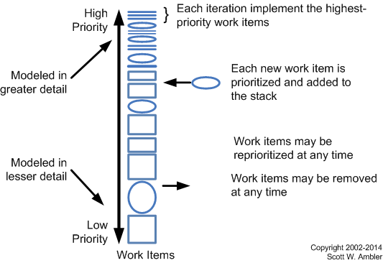
Agile Requirements Change Management
http://www.agilemodeling.com/essays/changeManagement.htm

Slide 18
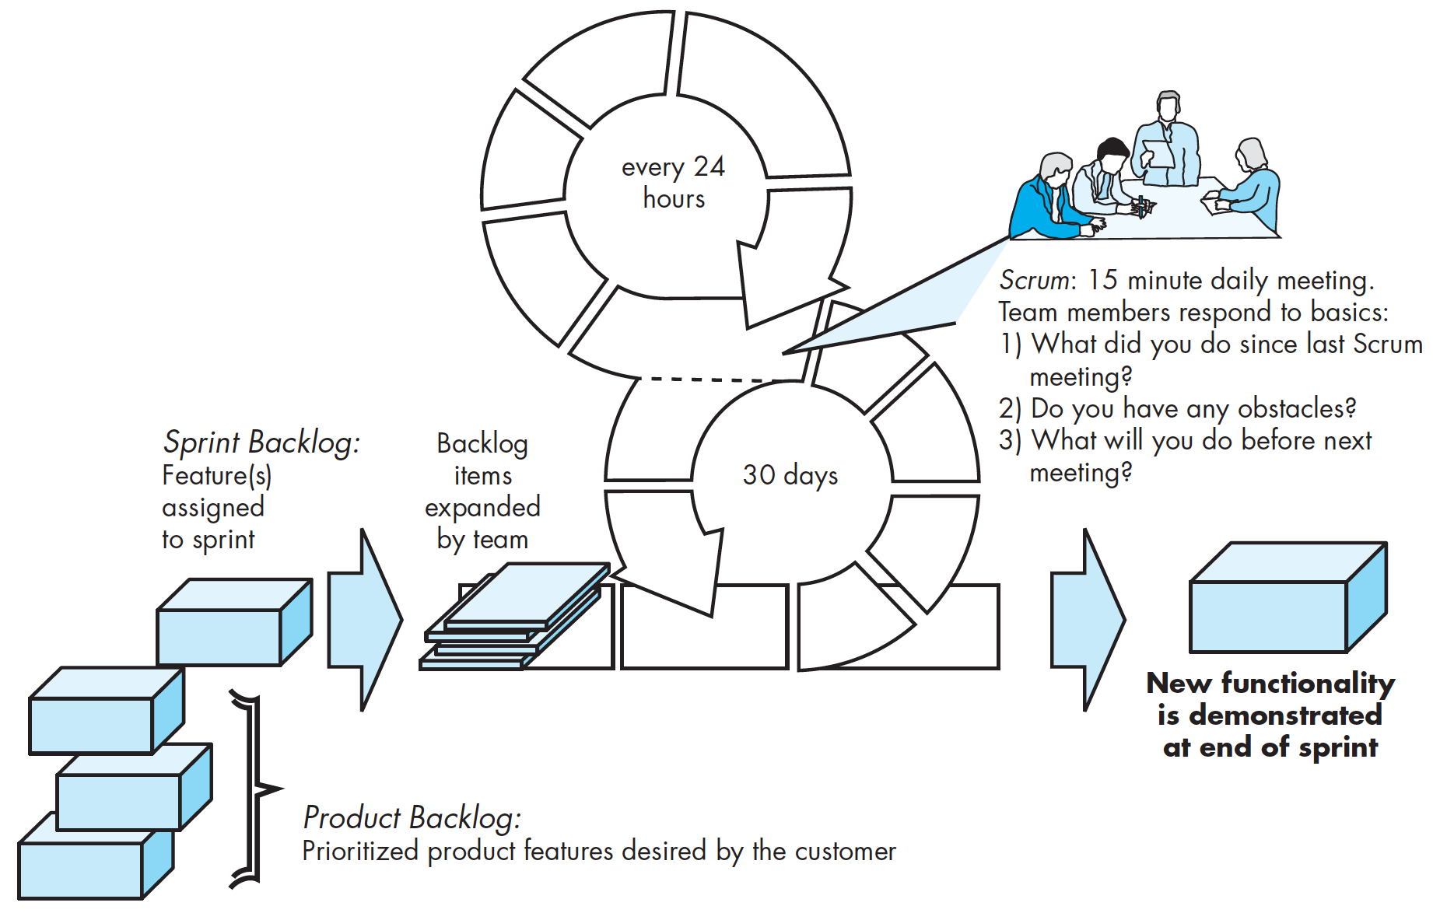
Scrum Meetings
Backlog Refinement Meeting: developers work with stakeholders to create the product backlog
Sprint Planning Meeting: backlog partitioned into “sprints” derived from the backlog and next sprint defined (sprint backlog items are prioritized)
Daily Scrum Meeting: team members synchronize their activities and plan a work day (15 minutes max.)
Sprint Review: prototype “demos” are delivered to the stakeholders at the end of a sprint
Sprint Retrospective: after sprint is complete, team considers what went well and what needs improvement (3 hours)
[PrMa20 ]
Example of a daily scrum meeting:
https://www.youtube.com/watch?v=q_R9wQY4G5I (3:40-5:40-8:30)

Slide 19
Pros and Cons of Scrum
[PrMa20 ]
Pros
Product owner sets priorities
Team owns decision making
Documentation is lightweight
Supports frequent updating
Cons
Difficult to control the cost of changes
May not be suitable for large teams
Requires expert team members
[PrMa20 ]

